Slide 1
Basic Data Structures Review
SDEV 301

Slide 2

Topics
Arrays
Array lists
Linked lists
Stacks
Queues
Trees

Slide 3
Arrays
Basic Data Structure Review

Slide 4
The array structure
Features
Fixed length data structure
Index-based access
char[] characters = new Char[8];
A | B | C | D
0 | 1 | 2 | 3 | 4 | 5 | 6 | 7

Slide 5
Array algorithms
How would you write a solution for the following problems?
Find the largest element in an array of integers. | Returns true if an input array of doubles is in sorted order (ascending), or false otherwise
Given an array of integers, returns the lowest index in the array that contains a negative number, or -1 if none are found. | Given an object array, returns true if the array contains any duplicate elements, or false otherwise

Slide 6
Array Lists
Basic Data Structures Review

Slide 7
Array Lists
Features
Offers dynamic resizing of an internal array
Elements are added until the array is full after which a new, larger array is created and all elements are copied to the new array
Index-based access
Drawbacks
Elements must be stored, without gaps, in the lower indices of the internal array
Shifting elements is costly
Internal Array
Used Space
Unused Space

Slide 8
ArrayList.add()
Adds a new element at the next available index
Method signature
public boolean add(T element)
A | B | C | null | null | null | null | null
0 | 1 | 2 | 3 | 4 | 5 | 6 | 7
add(A)
add(B)
add(C)

Slide 9
ArrayList.add()
The internal array is still fixed size
When the internal capacity is exceeded, a new array is created
The size of the new array is typically 2x or 1.5x the original size
add(D)
add(E)
add(F)
A | B | C | D | E
0 | 1 | 2 | 3 | 4
A | B | C | D | E | F | null | null | null | null
0 | 1 | 2 | 3 | 4 | 5 | 6 | 7 | 8 | 9

Slide 10
ArrayList.remove(element)
Removes the first occurrence of the given element from the array list. Returns true if the element is found.
Method signature
public boolean remove(T element)
Step #1
Sequentially scan the internal array using equals() to determine if the input is found
equals()
9 | 17 | 3 | -10 | 9 | 11 | 33 | 2
0 | 1 | 2 | 3 | 4 | 5 | 6 | 7

Slide 11
ArrayList.remove(element)
Step #2
Remove the element if present
This shifts all elements at higher indices to fill the gap
remove(B)
shift down one index
Before
A | B | C | D | E
0 | 1 | 2 | 3 | 4
After
A | C | D | E
0 | 1 | 2 | 3 | 4

Slide 12
ArrayList.clear()
The array list can be cleared by looping over all elements and setting them to null
This version of the operation is linear
data[i] = null
Before
9 | 17 | 3 | -10 | 9
0 | 1 | 2 | 3 | 4 | 5 | 6 | 7
After
0 | 1 | 2 | 3 | 4 | 5 | 6 | 7

Slide 13
ArrayList.clear()
The array list can also be cleared by altering the pointer that identifies next available index for insertion
Note: This can keep objects in the heap longer than intended
Before
9 | 17 | 3 | -10 | 9
0 | 1 | 2 | 3 | 4 | 5 | 6 | 7
nextIndex
After
9 | 17 | 3 | -10 | 9
0 | 1 | 2 | 3 | 4 | 5 | 6 | 7
nextIndex

Slide 14
ArrayList.contains(element)
Returns true if the given element is located in the array list, otherwise false
Method signature
public boolean contains(T element)
9 | 17 | 3 | -10 | 9 | 11 | 33 | 2
0 | 1 | 2 | 3 | 4 | 5 | 6 | 7

Slide 15
ArrayList.isEmpty()
Returns true if the array list is empty, otherwise false
Method signature
public boolean isEmpty()
Returns the number of elements in the array list
Method signature
public int size()
ArrayList.size()
capacity
size
Internal Array
Used Space
Unused Space

Slide 16
ArrayList.add(index, element)
Adds a new element at the given index
Method signature
public boolean add(int index, T element)
Scenario #1:
add() is invoked at index == size()
The new element is added to the next available index
add(5, F)
A | B | C | D | E
0 | 1 | 2 | 3 | 4

Slide 17
ArrayList.add(index, element)
Scenario #2:
add() is invoked on an occupied index
All elements from that index to size() – 1 are shifted up one position
add(D)
shift up one index
Before
A | B | C
0 | 1 | 2 | 3 | 4
After
A | D | B | C
0 | 1 | 2 | 3 | 4

Slide 18
Linked Lists
Basic Data Structures Review

Slide 19
Linked lists
Features
Offers a chain of linked nodes which each store a data element
Elements can be added repeatedly without resizing an array or shifting elements within the array
Index-based access
Drawbacks
Nodes contain extra pointers (references) which use more space for each element in the list
Traversal is costly for accessing elements by index
head
A
B
C
D
E

Slide 20
LinkedList.add(element)
Adds a new element at the next available index in the list
Method signature
public boolean add(T element)
New element
Before
head
A
B
C
D
E
After
head
A
B
C
D
E

Slide 21
LinkedList.add(element)
Calling add() on a singly linked list without tail pointer
head
A
B
C
D
E
Calling add() on a singly linked list with tail pointer
tail
tail
head
A
B
C
D
E

Slide 22
LinkedList.add(element)
Calling add() on a doubly linked list without tail pointer
head
A
B
C
D
E
Calling add() on a doubly linked list with tail pointer
tail
tail
head
A
B
C
D
E

Slide 23
LinkedList.remove()
Removes the first occurrence of the given element from the list. Returns true if the element is found.
Method signature
public boolean remove(T element)
Step #1
Sequentially scan the nodes of the list using equals() to determine if the input is found
head
A
B
C
D

Slide 24
Scenarios
Best case:
head
A
B
C
D
Worst case:
head
A
B
C
D
Average case:
head
A
B
C
D

Slide 25

LinkedList.remove(element)
Calling remove() on a singly linked list
head
A
B
C
D
E
Calling remove() on a doubly linked list
head
A
B
C
D
E

Slide 26
Special cases
Calling remove() on a singly linked list
head
A
B
C
D
E
Calling remove() on a doubly linked list
head
A
B
C
D
E

Slide 27
Special cases
Calling remove() on a singly linked list
head
A
B
C
D
E
Calling remove() on a doubly linked list
head
A
B
C
D
E

Slide 28
LinkedList.contains(element)
Reports whether an element is in the list or not. Returns true if the element is found or false otherwise.
Method signature
public boolean contains(T element)
head
A
B
C
D

Slide 29
LinkedList.get(), set()
get(index): Returns the element at position in the linked list.
set(index, element): updates an element at a position in the linked list.
Method signature
public T get(int index)
public T set(int index, T newValue)
head
A
B
C
D
0
1
3
4

Slide 30
LinkedList.get(index), set(index)
Example:
get(3)
head
A
B
C
D
0
1
3
4
set(4, E)
head
A
B
C
D E
0
1
3
4

Slide 31
LinkedList.clear()
Removes all elements from the linked list.
Method signature
public void clear()
before
head
A
B
C
D
0
1
3
4
after
head
A
B
C
D
0
1
3
4

Slide 32
Stacks & Queues
Basic Data Structures Review

Slide 33
Stacks vs. queues
Stacks
Queues
LIFO structure
The most recently added element is always removed first.
No index-based access
Often used to reverse the elements of a collection
FIFO structure
Elements are removed in the order they are inserted
No index-based access
Often used to track a list of sequential tasks
enqueue()
pop()
A
push()
C
B
A
B
B
B
C
B
A
A
A
A
A
C
B
dequeue()

Slide 34
Array-based stack
Structure
Array-based stack
The top of the stack is the highest used index in the array
push(E)
pop()
Before
A
B
C
D
Before
A
B
C
D
After
A
B
C
D
E
After
A
B
C

Slide 35
Array-based stack
Structure
Array-based stack
The top of the stack is the lowest index in the array
push(E)
pop()
Before
D
C
B
A
Before
D
C
B
A
After
E
D
C
B
A
After
C
B
A

Slide 36
Linked-list-based stack
Structure
Linked-list-based stack
The top of the stack is the highest used index in the linked list
Assume:
The list is doubly linked
The list has a tail pointer
pop()
push(E)
head
A
B
C
D
tail

Slide 37
Linked-list-based stack
Structure
Linked-list-based stack
The top of the stack is the lowest used index in the linked list
Assume:
The list is doubly linked
The list has a tail pointer
push(E)
pop()
head
A
B
C
D
tail

Slide 38
Array-based queue
Structure
Array-based queue
The front of the queue is the highest used index in the array
enqueue()
dequeue()
back
front
D
C
B
A
D
C
B
A

Slide 39
Array-based queue
Structure
Array-based queue
The front of the queue is the lowest index in the array
dequeue()
enqueue()
front
back
A
B
C
D
D
C
B
A

Slide 40
Linked-list-based queue
Structure
Linked-list-based queue
The front of the queue is the highest used index in the linked list
enqueue()
dequeue()
head
A
B
C
D
tail

Slide 41
Linked-list-based queue
Structure
Linked-list-based queue
The front of the queue is the lowest index in the linked list
dequeue()
enqueue()
head
A
B
C
D
tail

Slide 42
Trees
Basic Data Structures Review

Slide 43
Definitions
A tree is a non-linear search structure
Often a link-based structure, similar to linked lists, with nodes referencing other nodes
A node can now contain multiple references to other nodes
Use to speed up search times for comparable data
a
b
c
d
e
f
g

Slide 44
Terminology
Each tree has a branching factor
A tree where each node can have up to k children is called a k-ary tree
Many algorithms focus on binary trees where k = 2
a
Binary Tree
a
Ternary Tree
b
d
b
c
d
e
f
h
e
f
g
h
g
i
j
i
j

Slide 45
Terminology - relationships
Node references are typically one-way
A node that references another node is called a parent, whereas the referenced nodes are called children
This is synonymous with terminology related to class hierarchies in OOP languages
parent node
a
b
c
d
child nodes

Slide 46
Terminology – node types
Root: A tree structure will only store directly a reference to the top-most node in the tree, called the root
This is similar to the head reference in a linked list
Leaf: A node with no children is called a leaf and represents a terminal end to a search in the tree
Internal node: a node with at least one child is called an internal node
The root may or may not be an internal node
root
a
b
d
e
f
h
g
i
j
- leaf node
- internal node

Slide 47
Search trees
Various types of search trees are popular, as a way to speed up search times
We want to avoid linear search times in lists
A binary search tree is a binary tree with the following property for each node in the tree
all elements in the left sub-tree must be less than the parent
all elements in the right sub-tree must be less than the parent
< A
A
> A
?
?
?
?
?
?
?
?
Left sub-tree
Right sub-tree

Slide 48
Which of the following are binary search trees?
15
11
12
30
8
17
-6
22
33
36
9
23
16
27
Examples
H
menu
C
M
jump
quack
A
L
R
eat
straw
red
J
O
W
bird
S
Y

Slide 49
Building a BST
Insert the following elements into a BST from left-to-right: 33, 48, 40, 22, -10, 10, 0, 55, 46
33
33
33
33
33
33
48
48
22
48
22
48
22
48
40
40
-10
40
-10
40
10

Slide 50
Building a BST
Insert the following elements into a BST from left-to-right: 33, 48, 40, 22, -10, 10, 0, 55, 46
33
33
33
22
48
22
48
22
48
-10
40
-10
40
55
-10
40
55
10
10
10
46
0
0
0

Slide 51
Insertion order matters
The order in which you insert new elements determines the shape of the tree:
-10, 48, 10, 22, 55, 40, 0, 46, 33
-10, 0, 10, 22, 33, 40, 46, 48, 55
-10
-10
48
0
10
55
10
0
22
22
40
33
33
46
…

Slide 52
Searching through a BST
Searches always begin at the root making decisions based on the search key
Left if the search key is smaller than the current node
Right if the search key is larger than the current node
Search: 10
33
Search: 43
33
Search: 33
33
22
48
22
48
22
48
-10
40
55
-10
40
55
-10
40
55
10
10
10
0
0
0

Slide 53
Node height
The height of a node in a BST is calculated as the number of links on the longest path to a leaf node
-10
Height = 5
48
Height = 3
10
55
Height = 0
0
22
40
Height = 1
33
46

Slide 54
Node depth
The depth of a node in a BST is calculated as the number of links from the root to a node
-10
Depth = 0
48
Depth = 2
10
55
0
22
Depth = 3
40
33
46
Depth = 5

Slide 55
Practice
Determine the height and depth of each node from the following BST
Node | Height | Depth
A
C
H
J
L
M
O
R
S
W
Y
H
C
M
A
L
R
J
O
W
S
Y

Slide 56
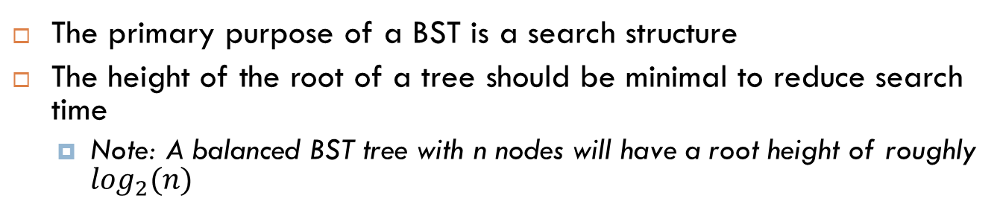
Tree balance
The primary purpose of a BST is a search structure
The height of the root of a tree should be minimal to reduce search time
Note: A balanced BST tree with n nodes will have a root height of roughly $\log_{2}(n)$
22
Unbalanced Tree
Balanced Tree
33
-10
33
22
48
10
48
-10
30
40
55
0
40
0
46
46
55

Slide 57
Tree traversals
Tree traversals are used to visit each node in the tree
Different traversals produce different orderings of the nodes in the tree
Note: All traversals visit each node in the tree
Common traversals
Post, Pre, and In-Order traversals
BFS and DFS traversals
33
22
48
-10
40
55
10
46
0
Traversal: 33, 22, -10, 10, 0, …

Slide 58
Pre-Order traversal
Visits a node and children in the following order: node, left-child, right-child
33
33
33
22
48
22
48
22
48
-10
40
55
-10
40
55
-10
40
55
10
46
10
46
10
46
0
0
0
Traversal
33, …
Traversal
33, 22, …
Traversal
33, 22, -10, …

Slide 59
Pre-Order traversal
Visits a node and children in the following order: node, left-child, right-child
33
33
33
22
48
22
48
22
48
-10
40
55
-10
40
55
-10
40
55
10
46
10
46
10
46
0
0
0
Traversal
33, 22, -10, 10, …
Traversal
33, 22, -10, 10, 0, …
Traversal
33, 22, -10, 10, 0, 48, …

Slide 60
Pre-Order traversal
Visits a node and children in the following order: node, left-child, right-child
33
33
33
22
48
22
48
22
48
-10
40
55
-10
40
55
-10
40
55
10
46
10
46
10
46
0
0
0
Traversal
33, 22, -10, 10, 0, 48,
40…
Traversal
33, 22, -10, 10, 0, 48,
40, 46…
Traversal
33, 22, -10, 10, 0, 48,
40, 46, 55

Slide 61
Post-Order traversal
Visits a node and children in the following order: left-child, right-child, node
33
33
33
22
48
22
48
22
48
-10
40
55
-10
40
55
-10
40
55
10
46
10
46
10
46
0
0
0
Traversal
0, …
Traversal
0, 10, …
Traversal
0, 10, -10, …

Slide 62
Post-Order traversal
Visits a node and children in the following order: left-child, right-child, node
33
33
33
22
48
22
48
22
48
-10
40
55
-10
40
55
-10
40
55
10
46
10
46
10
46
0
0
0
Traversal
0, 10, -10, 22, …
Traversal
0, 10, -10, 22, 46, …
Traversal
0, 10, -10, 22, 46, 40, …

Slide 63
Post-Order traversal
Visits a node and children in the following order: left-child, right-child, node
33
33
33
22
48
22
48
22
48
-10
40
55
-10
40
55
-10
40
55
10
46
10
46
10
46
0
0
0
Traversal
0, 10, -10, 22, 46, 40,
55, …
Traversal
0, 10, -10, 22, 46, 40,
55, 48, …
Traversal
0, 10, -10, 22, 46, 40,
55, 48, 33

Slide 64
In-Order traversal
Visits a node and children in the following order: left-child, node, right-child
33
33
33
22
48
22
48
22
48
-10
40
55
-10
40
55
-10
40
55
10
46
10
46
10
46
0
0
0
Traversal
-10, …
Traversal
-10, 0, …
Traversal
-10, 0, 10, …

Slide 65
In-Order traversal
Visits a node and children in the following order: left-child, node, right-child
33
33
33
22
48
22
48
22
48
-10
40
55
-10
40
55
-10
40
55
10
46
10
46
10
46
0
0
0
Traversal
-10, 0, 10, 22…
Traversal
-10, 0, 10, 22, 33…
Traversal
-10, 0, 10, 22, 33, 40, …

Slide 66
In-Order traversal
Visits a node and children in the following order: left-child, node, right-child
33
33
33
22
48
22
48
22
48
-10
40
55
-10
40
55
-10
40
55
10
46
10
46
10
46
0
0
0
Traversal
-10, 0, 10, 22, 33, 40,
46, …
Traversal
-10, 0, 10, 22, 33, 40,
46, 48, …
Traversal
-10, 0, 10, 22, 33, 40,
46, 48, 55

Slide 67
Practice
Give the following traversals on the BST seen below
Pre-order ___________________________
Post-order __________________________
In-order ____________________________
33
22
48
-10
30
40
55
0
46
54
61
-4
7
52
-8

Slide 68
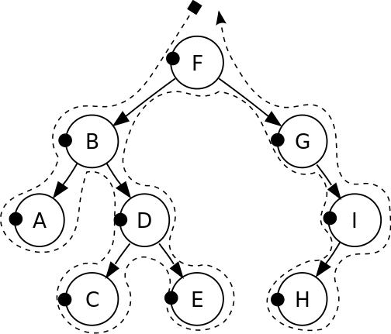
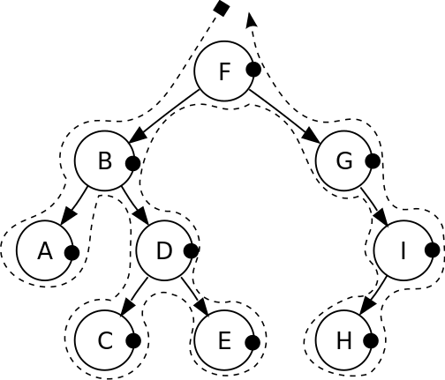
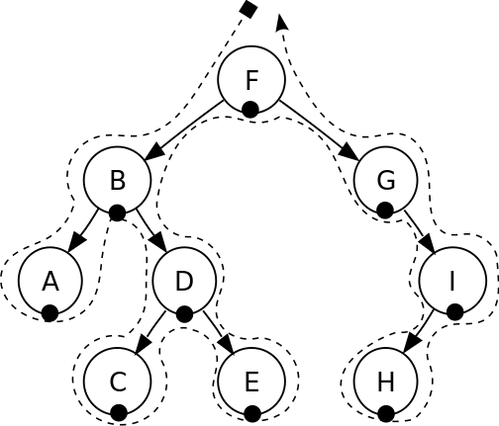
Tree traversals
General themes around the traversals
In-order – returns elements in sorted order (important!)
Post-order – a bottom-up search
Pre-order – a top-down search
When in doubt use the “sailing method”
Pre-order
Post-order
In-order

Slide 69
Basic Data Structures Review
SDEV 301

